Slide 1
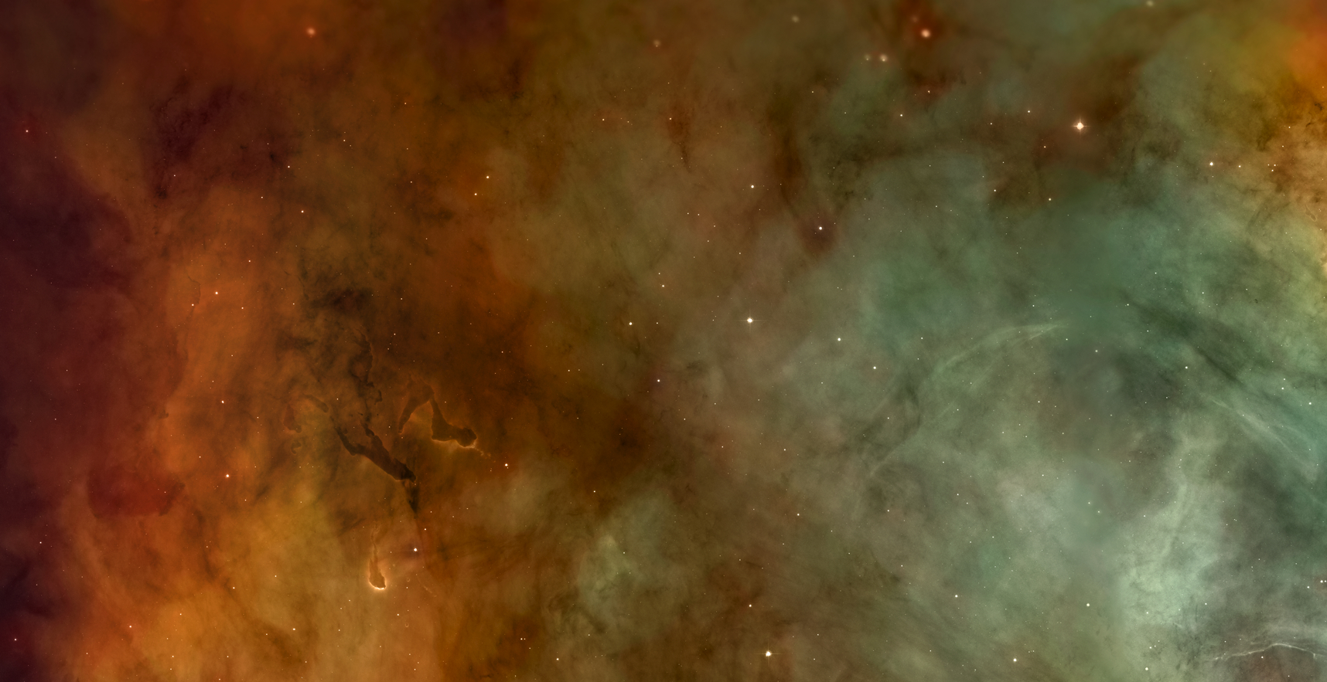
In this series of images, we travel across enormous leaps of scale to go from local stars out to the earliest galaxies.

Slide 2
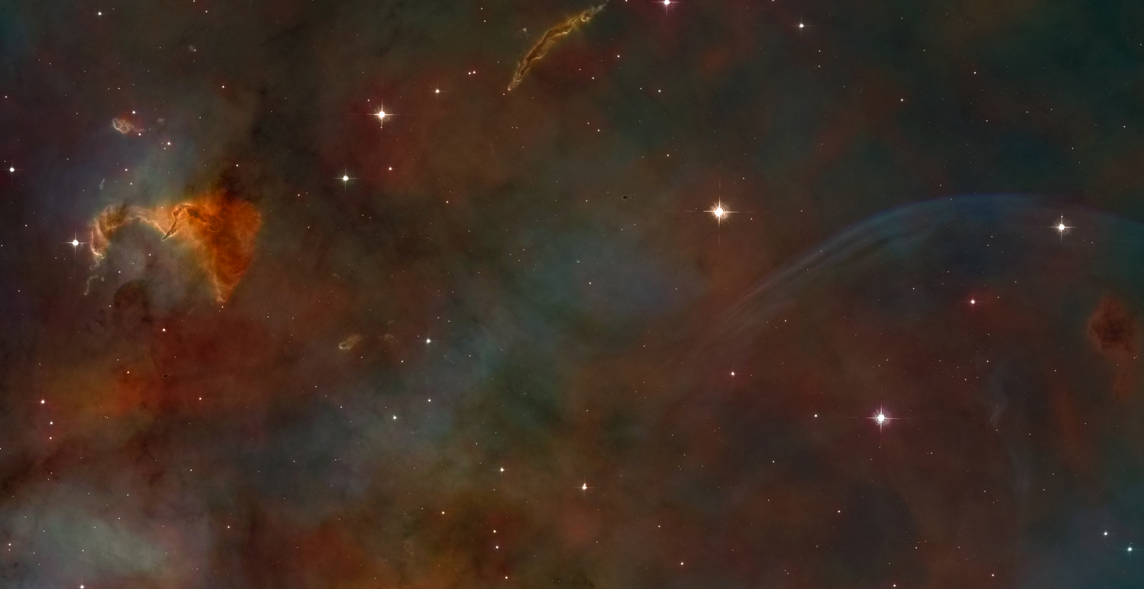
Colors in the images were applied for scientific and also aesthetic purposes, mapping either chemical composition or the range of energies included in the data.

Slide 3
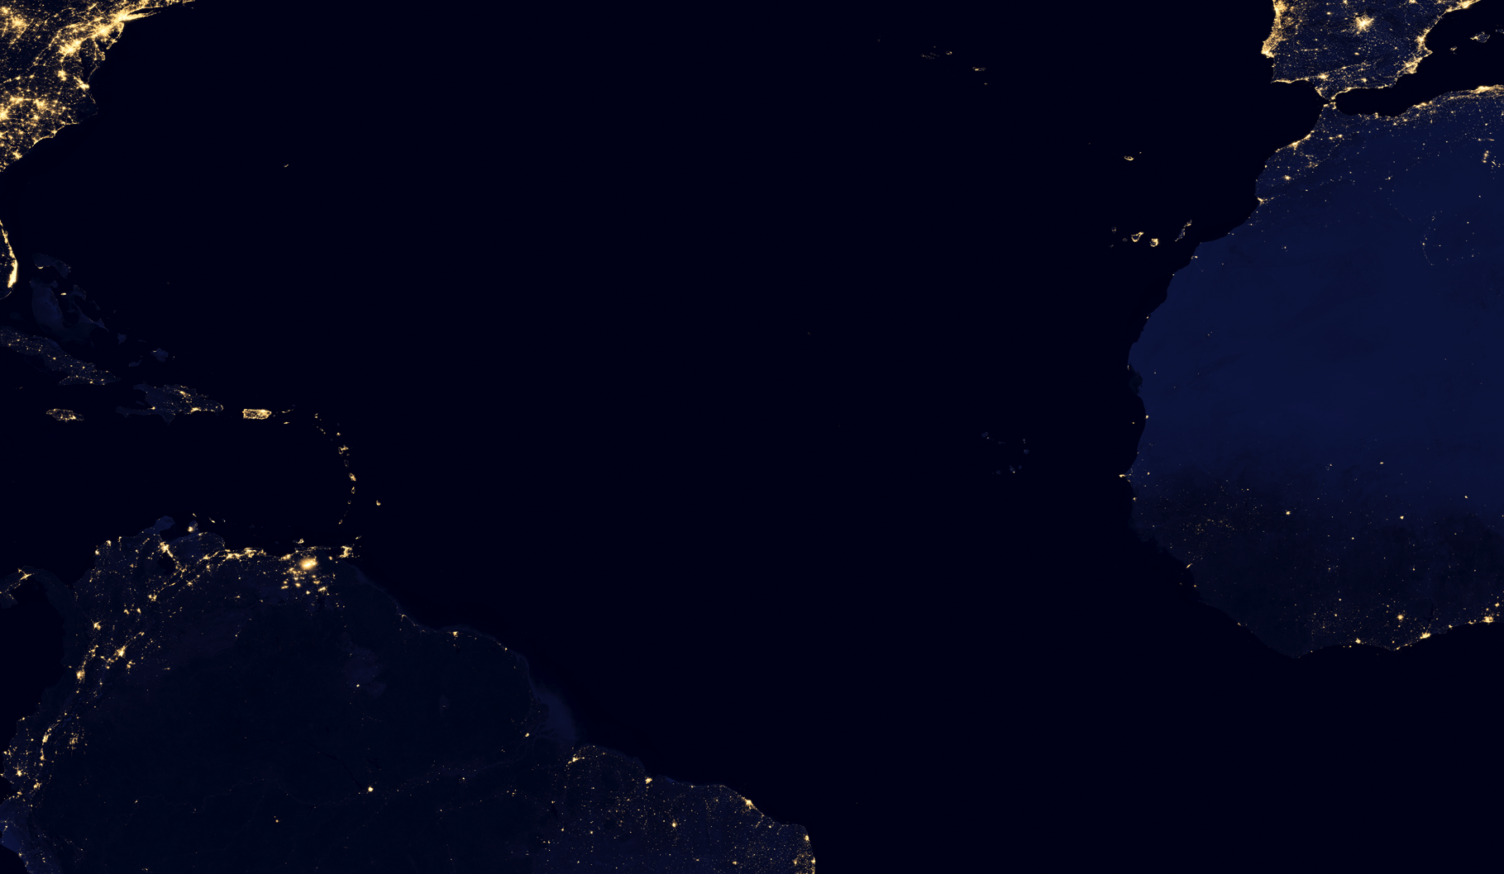
By compositing a series of images together, we can get a more complete picture of what Earth looks like at night.

Slide 4
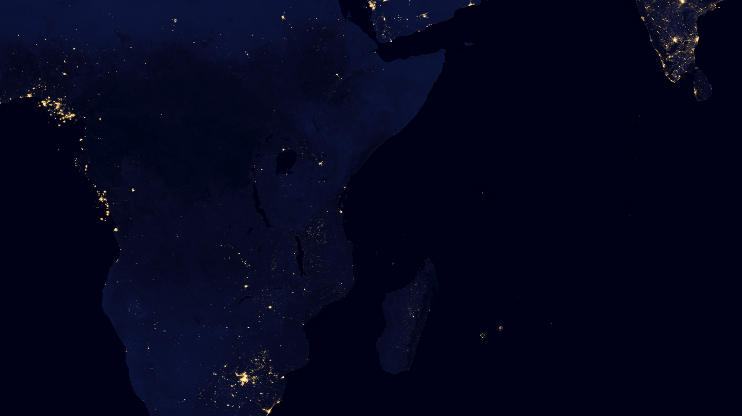
This data is being used to map not only urbanization and light pollution, but also help us to understand how such issues can impact fragile ecosystems.

